Slide 1
QA Project
Anime Watchlist
Umayr Ahmed
The brief
My ERDs
Testing
Front End
Demonstration
Summary

Slide 2
The brief
Our overall objective for the project was:
To create a CRUD application with utilisation of supporting tools, methodologies and technologies that encapsulate all core modules covered during training.
This includes:
The use of two tables that share a relationship
Fully functional CRUD application
Integration into a version control system
The brief
My ERDs
Testing
Front End
Demonstration
Summary

Slide 3
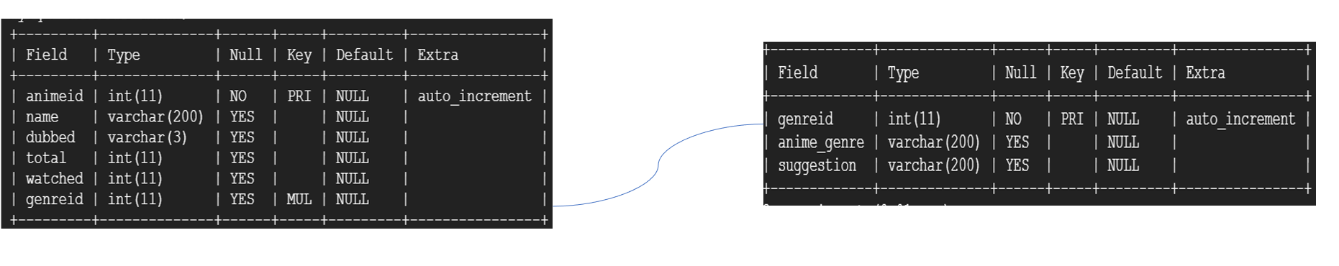
My solution
The brief
My ERDs
Testing
Front End
Demonstration
Summary

Slide 4
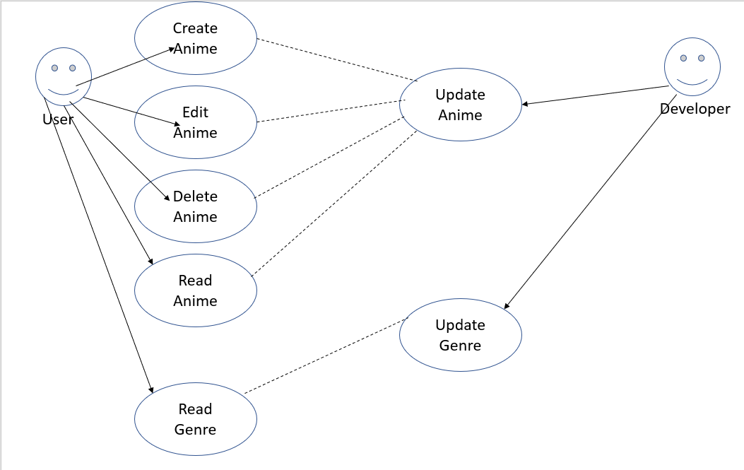
My solution
The brief
My ERDs
Testing
Front End
Demonstration
Summary

Slide 5
Bootstrap
<a href="/update/{{row.animeid}}" class="btn btn-warning btn-xs" data-toggle="modal" data-target="#modaledit{{row.animeid}}">Update</a>
<a href="/delete/{{row.animeid}}" class="btn btn-danger btn-xs" onclick="return confirm('Are You Sure You Want To Delete Anime From Watchlist ?')">Delete</a>
The brief
My ERDs
Testing
Front End
Demonstration
Summary

Slide 6
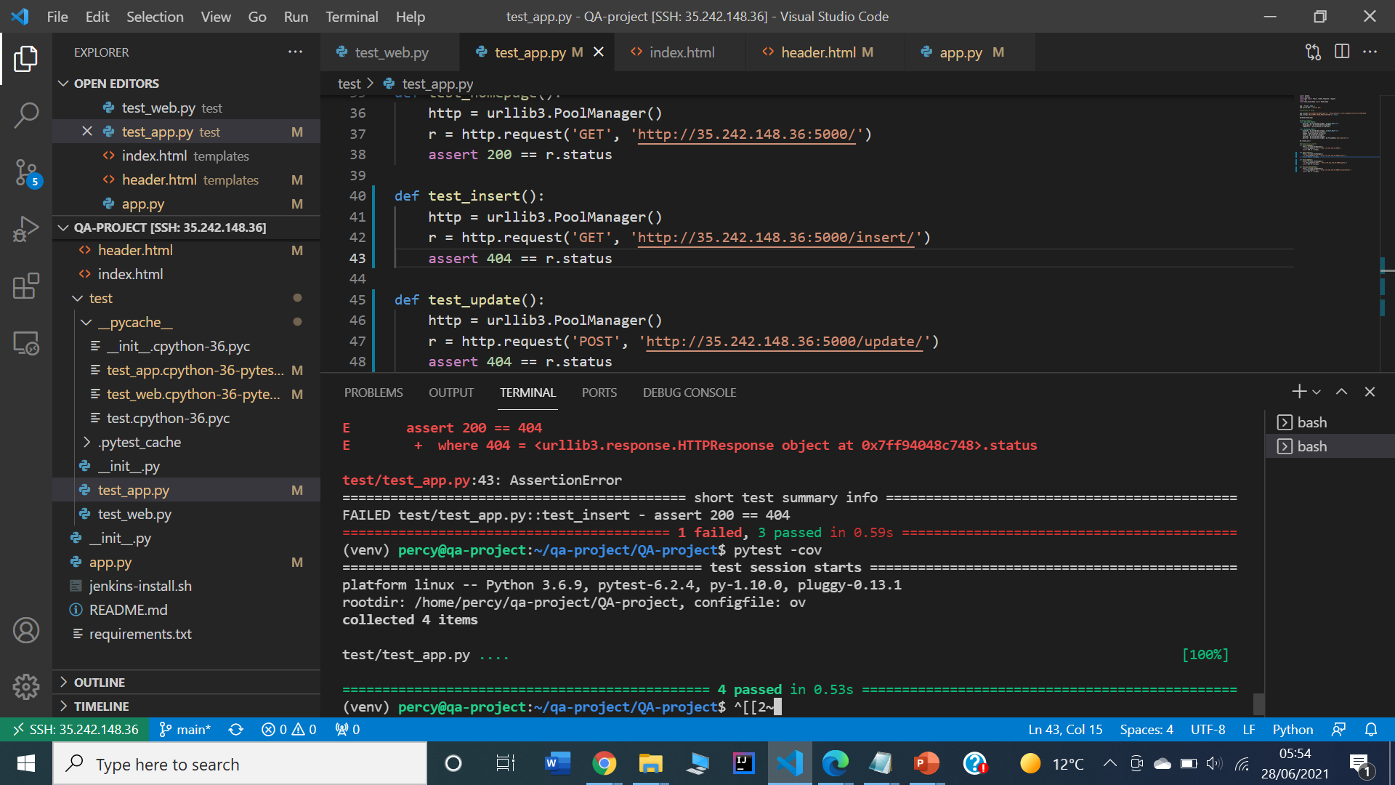
Testing: PyTest
The brief
My ERDs
Testing
Front End
Demonstration
Summary

Slide 7
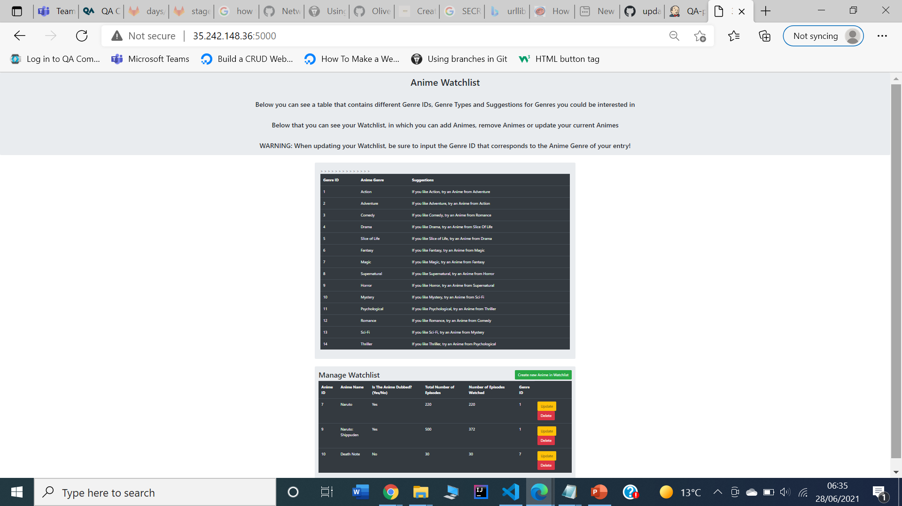
Front End
The brief
My ERDs
Testing
Front End
Demonstration
Summary

Slide 8
Retrospective
What went well
Use of relationships in tables
Use of Agile Methodology
Use of webhook linking Github to Jenkins
Learning and use of Bootstrap
CRUD application is fully functional
The brief
My ERDs
Testing
Front End
Demonstration
Summary

Slide 9
Retrospective
What could have gone better and Improvements for the future
Use Test Driven Development
Improve on Test Coverage and use of Integration Testing
Better Management of Time to account for issues
The brief
My ERDs
Testing
Front End
Demonstration
Summary

Slide 10
Demonstration
˃ Demonstration of finished project

Slide 11
Questions and Feedback
˃ Thank you for listening

